Slide 1



Game-Based Interactive
Learning System
AI-Assisted Platform for Learning Programming Concepts through Interactive Game Mechanics
PRESENTED BY
COURSE
PROJECT GUIDE
M. Akshay Yadav
100524862041
OU - MCA Major Project
IV Semester - 2026
Dr.V.Sukanya

Slide 2
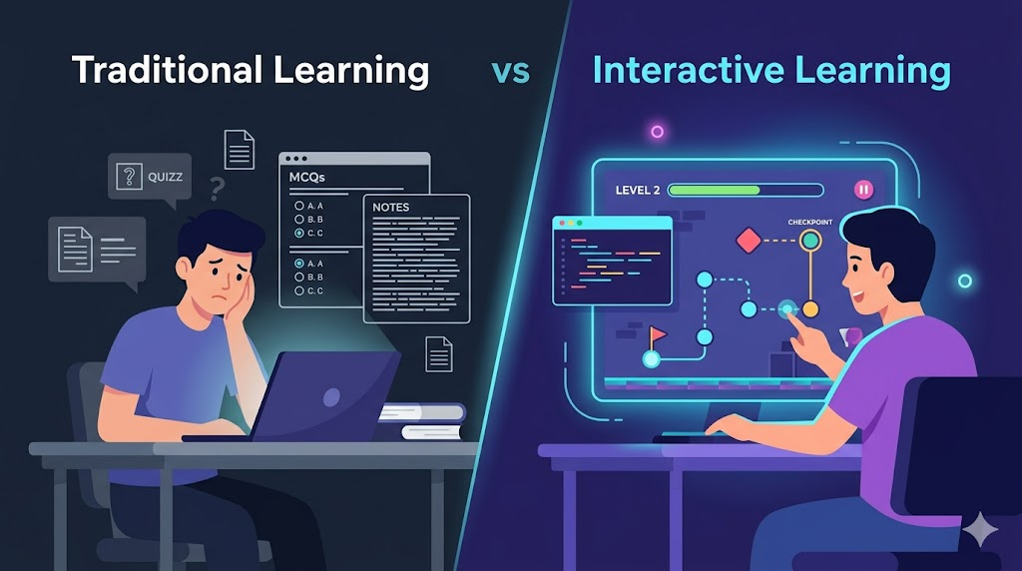

PROBLEM STATEMENT
Passive learning methods (MCQs) fail to build logic
Lack of interactivity leads to loss of motivation
Significant difficulty in visualizing abstract logic
High manual effort required for exercise creation
Existing platforms ignore the learning experience
Core Problem:
Students need a more engaging and practical way to understand programming concepts beyond static quizzes.

Slide 3





PRIMARY OBJECTIVE
To develop a gamified learning platform that enables students to learn programming concepts through interactive game-based challenges.
Specific Objectives
Convert programming topics into structured game levels
Enable teachers to create subjects and manage content
Integrate AI to assist in automatic level generation
Support multiple valid solutions for coding challenges
Track student progress using scoring and ranking systems
Build scalable full-stack system architecture

Slide 4


LITERATURE SURVEY
Deterding et al. (2011)
OpenAI Research (2023)
Gamification Design Framework: Core principles for digital systems.
Generative AI: Use of AI in generating educational explanations.
Gap: Lacks specific implementation for programming education.
Gap: Focuses on tutoring, not structured game systems.
Hamari et al. (2014)
Kumar et al. (2024)
Motivation Study: Gamification improves participation significantly.
Retention Study: Leaderboards increase persistence in learning.
Gap: Does not address technical design of interactive coding.
Gap: Relies heavily on manually created content.
Code.org (2020)
Wang et al. (2024)
Interactive Framework: Benefits of visual coding for basics.
Adaptive Systems: discusses personalizing difficulty with AI models.
Gap: Limited flexibility for teacher-customized paths.
Gap: Limited focus on practical coding exercises.
García et al. (2021)
Li et al. (2025)
Problem Solving: Logic improvement via structured digital games.
Automated Generation: uses LLMs for learning materials.
Gap: Does not integrate AI-assisted generation.
Gap: No integration into interactive game environments.
LITERATURE GAP SUMMARY
•
Focus on gamification without AI support
•
Manual content creation reliance
•
Quizzes emphasized over practical coding
•
Lack of teacher-driven customization
•
AI used but missing interactive environments

Slide 5


WHAT’S UNIQUE ?
Learning through game mechanics instead of quizzes
AI-assisted level generation reduces manual effort
Supports multiple valid coding solutions
Data-driven level design architecture
Combines gamification with ed-tech research
Contribution: Bridges the gap between theoretical learning and practical coding skills.

Slide 6






PROPOSED SYSTEM SOLUTION
Game-Centric Pedagogy
AI-Driven Orchestration
Dynamic Evaluation
Translating abstract Python syntax (Loops, Conditionals, Data Structures) into interactive level mechanics. Each level serves as a sandbox where code logic directly influences game world state.
Integration of Generative AI (LLMs) to automate challenge synthesis. AI parses teacher-defined topics to generate unique problem statements, boilerplate code, and hidden test cases.
A robust execution engine that validates submissions against multiple test scenarios. Unlike static checkers, it supports varied valid coding approaches and provides instant logical feedback.
TEACHER SUITE
REAL-TIME IDE
SOCIAL LAYER
LOGIC ANALYTICS
CRUD operations for subjects, topics, and difficulty constraints.
Integrated browser-based code editor with syntax highlighting.
Global leaderboards, experience points (XP), and badge unlocks.
Heatmaps and detailed performance logs for individual concepts.
PRIMARY GOAL: Transforming theoretical syntax mastery into Applied Algorithmic Problem-Solving

Slide 7
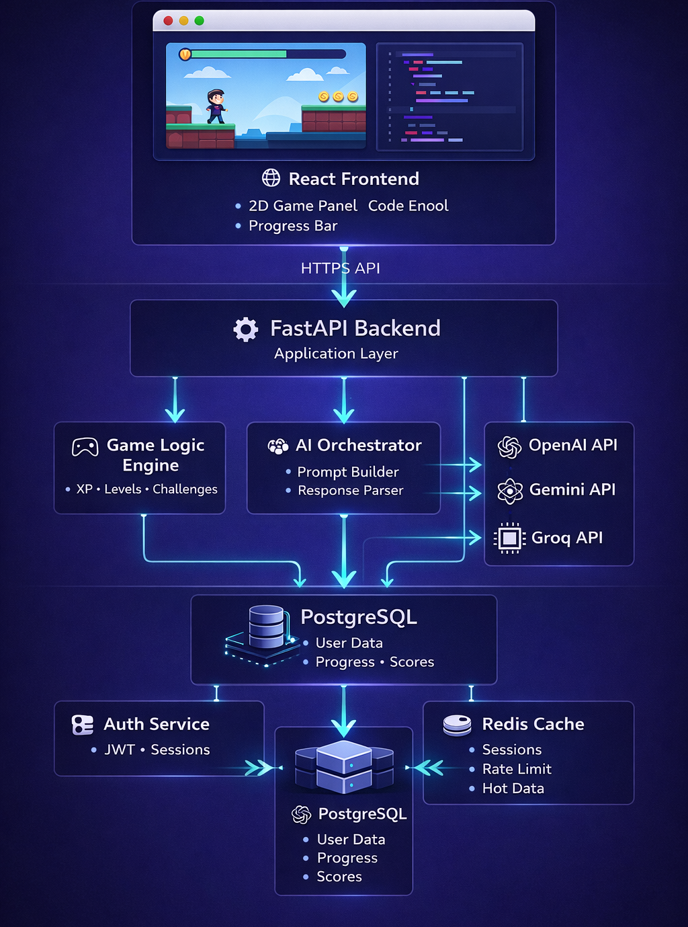
SYSTEM ARCHITECTURE
THE STACK
Modules:
Authentication & Security Module
Subject Management Module
Game Engine & Evaluation Engine
AI Content Generator (OpenAI/Gemini/Local LLM)
Analytics & Leaderboard Module

Slide 8
METHODOLOGY
Step 1
Step 3
Step 5
Teacher creates subject and topics
Students play interactive coding games
Teacher monitors analytics dashboard
Step 2
Step 4
AI assists in generating level content
System evaluates solutions automatically
LEARN → APPLY → EVALUATE → IMPROVE → PROGRESS

Slide 9






EXPECTED OUTCOMES
Educational
Technical
User Experience
Improved engagement
Scalable full-stack system
Interactive experience
Better conceptual logic
Structured content architecture
Measurable improvement
Enhanced logical thinking
Competitive motivation
Reusable generation pipeline

Slide 10


FUTURE ENHANCEMENTS
Additional programming languages
Conclusion
Adaptive difficulty using AI
"Game-based learning combined with AI can transform programming education into an engaging experience."
Multiplayer challenge mode
Integration with LMS platforms
Thank You
Personalized learning paths
QUESTIONS?

